Slide 1
BioProcess Technology
Slot: B: CH6460
Gmeetlink: https://meet.google.com/dgo-gcwf-dfs
Devarai Santhosh Kumar

Slide 2
Large-scale Animal Cell Cultures or Eukaryotes : Design and Operational Considerations

Slide 3
“ Make experiments on a small scale and obtain profits on a large scale on the basis of specific criteria”
Manufacture of biological products like proteins, antibiotics, enzymes etc., great interest
Deer need for processing these compounds especially proteins has to scale up with rational approach in terms of design and large-scale of animal cell cultures.
Despite the early enthusiasm these proteins source is from microorganism like bacteria, fungi and yeast.
Cell culture engineering still depends on scale-up procedures developed for chemical or microbial and biochemical process

Slide 4
Processing these therapeutic protein products have encountered following difficulties:
Many protein products are glycosylated; complex step not easily achieved
Post translation modification in terms of conformation and desired biological activity
Oxygen transfer limitation
Protein molecule not easily secreted in these system
Shear sensitivity of mammalian/ hybridoma cells

Slide 5
Overcome such problem need very well equipped design challenge with following requirements : Bioreactors
Cellular aspects
Cell density:
To increase product rate / product concentration by high cell density without serum content
Generally suspension cell culture ~ 2 to 3 × 10⁶
In immobilized system range up to ~ 2 to 3 × 10⁸
Advantage with cell density, cost effective in down-stream processing
Disadvantage; scale-up, oxygen limitation and mass transfer effects

Slide 6
Cellular productivity:
It is an intrinsic mechanism of cell and gene manipulations, it require post-translation eg,.glycosylation and folding
It depends on cell specific productivity, rate of transcription, translation, product inhibit and product secretion rate
It requires good engineering aspect for development of automatic control process like temperature, pH, D.O
continue…..

Slide 7
Immobilization/ attachments:
“These technique is useful in physical or chemical entrapment of cells, in order to increase the stability and make reuse of cells”.
It keeps the activity for a longer period than in solution and prevents downstream contamination of product.
Major problem is “ contact inhibition”
Such problem can be solved by micro-carriers and others matrices which provides conductive atmosphere for cell growth as well as to grow in multiple layers
Similarly, it reduce the growth rate of cells and increases the product rates
In case of tissue-culture it has shown by cultivation in three dimension matrices it helps in improvements in cell-cell contact and cell-matrices interactions enhance cell specific productivity.

Slide 8
Cell rigidity
Generally absence of cell-wall makes animal cell very fragile
Even shear stress is sensitivity in animal cells which leads to serious limitation in hybridoma cell lines
Research is concentrating in cell culture bioreactors, quantifying the effect of shear on cell growth, cell damage and lysis
Developing novel methods like aeration/agitation to minimize the shear and immobilization techniques in bulk environment
Shear stress is an important parameter in the design aspects for scale-up of animal cell bioreactors

Slide 9
Genetic stability
The other important parameter to be consider in animal cell is cell’s genome and stability of the gene
Again by using various matrices like chemical entrapment can be used to reduce the reduction rate in the mitosis, which help in genetic information maintainence
e.g. sodium alginate, k-carragennane, agar, gelatin, polyacrimilide etc

Slide 10
Bioreactors Aspects: ‘Heart of Biotechnology’
Extensive research has been concentrated on bioreactors for desired product for commercial purpose.
special interest has shown in process design, biological aspects and economic factors
Various factors should be consider for bioreactors:
The cell system
Chemical engineering aspects
Mechanical process
Reactors types
Mode of operation
And scale-up

Slide 11
TABLE OF CONTENTS
1. Introduction
● Bioprocess Design
● Novel Bioreactor Types
● Design Criteria for Bioreactors
2. Aeration and Oxygen Mass Transfer in Bioreactor Systems
● Oxygen Requirements by Microorganisms
● The volumetric Mass Transfer Coefficient K_{L}a and Methods of Measurements
● Empirical Correlations of K_{L}a

Slide 12
3. Agitation of Bioreactor Systems
4. Scale-up of Bioreactor Systems
● Scale-up Criteria
● Example of Geometric Scale-up
5. Sterilization of Liquid Media
● Kinetics of Thermal Death of Microorganisms
● Batch Sterilization of Liquid Media
● Continuous Sterilization of Liquid Media
● Examples of Design for Continuous Liquid Medium Sterilization in a Tubular Sterilizer

Slide 13
Air Sterilization by Fibrous Bed Filters
● Mechanisms of Air Filtration and Design of Fibrous Packed Beds
● Example of Design of Fibrous Packed Bed for Air Sterilization

Slide 14
Bioreactors

Slide 15
GENERALIZED VIEW OF BIOPROCESS
RAW MATERIALS
UPSTREAM PROCESSES
Inoculum
Preparation
Equipment
Sterilization
Media Formulation
and
Sterilization
BIOREACTOR - FERMENTER
Reaction Kinetics
and Bioactivity
Fluid Properties
Instrumentation
and Control
DOWNSTREAM PROCESSES
Separation
Recovery and
Purification
Waste Recovery,
Reuse and Treatment
THE BOTTOM LINE
REGULATION
ECONOMICS
HEALTH AND SAFETY

Slide 16
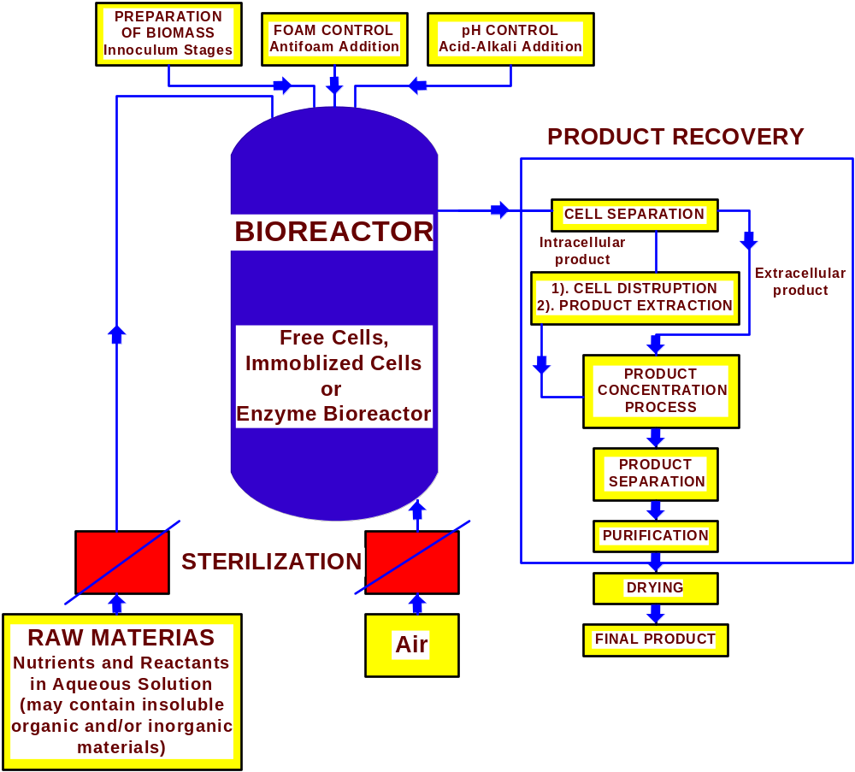
TYPICAL BIOPROCESS FLOW SHEET

Slide 17
TABLE 1. Basic Bioreactor Design Criteria
_________________________________________________________________
● Microbiological and Biochemical Characteristics of the Cell System (Microbial, Mammalian, Plant)
● Hydrodynamic Characteristics of the bioreactor
● Mass and Heat Transfer Characteristics of the Bioreactor
● Kinetics of the Cell Growth and Product Formation
● Genetic Stability Characteristics of the Cell System
● Aseptic Equipment Design
● Control of Bioreactor Environment (both macro- and micro-environment)
● Implications of Bioreactor Design on Downstream Products Separation
● Capital and Operating Costs of the Bioreactor
● Potential for Bioreactor Scale-up
______________________________________________________________________

Slide 18
Bioreactor Analysis and Operation
Overview of bioreactors for submerged system
- Classification:
operation modes:
- batch: stirred tank
- continuous: chemostat, fluidized-bed
- modified types of the above modes: fed-batch, chemostat with recycle,
multi-stage continuous reactors
Oxygen supply:
- aerobic: airlift
- anaerobic
Form of biocatalyst:
free cell (enzyme)
immobilized cell (enzyme)
packed-bed, membrane reactor

Slide 19
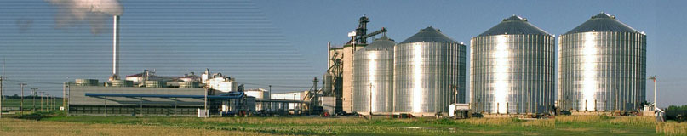
Industrial Bioreactor
Glacial Lakes Energy in Watertown, South Dakota
47+ million gallon per year ethanol production .

Slide 20
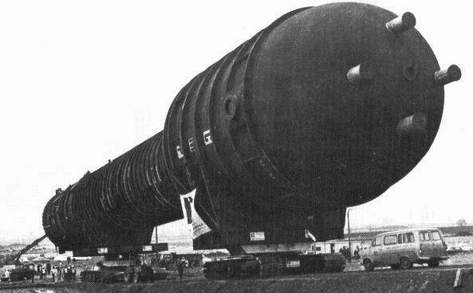
World's Largest Industrial Fermenter (Chem. Eng. News,10-Apr-78)
The fermenter is 200' high and 25 ft diam.

Slide 21
TABLE 2. Summary of Bioreactor Systems
________________________________________________________
Bioreactor Cell Systems Products
Design used
__________________________________________________________
● Air-Lift Bioreactor Bacteria, Yeast and SCP, Enzymes, Secondary other fungi metabolites, Surfactants
● Fluidized-Bed Immobilized bacteria, Ethanol, Secondary
Bioreactor yeast and other fungi, metabolites, Wastewater
Activated sludge treatment
● Microcarrier Immobilized (anchored) Interferons, Growth factors,
Bioreactor mammalian cells on Blood factors, Monoclonal
solid particles antibodies, Vaccines, Proteases,
Hormones
● Surface Tissue mammalian, tissue Interferons, Growth factors,
Propagator growth on solid surface, Blood factors,
tissue engineering Monoclonal antibodies, Vaccines, Proteases, Hormones
__________________________________________________________

Slide 22
TABLE 2. Summary of Bioreactor Systems (Cont’d)
____________________________________________________________________________________________________
Bioreactor Cell Systems used Products
Design
________________________________________________________________________________________
● Membrane Bioreactors, Bacteria, Yeasts, Ethanol, Monoclonal anti-
Hollow fibers and Mammalian cells, Plant bodies, Interferons, Growth
membranes used, cells factors, Medicinal products
Rotorfermentor
● Modified Stirred Immobilized Bacteria, Ethanol, Monoclonal anti-
Tank Bioreactor Yeast, Plant cells bodies, Interferons, Growth factors
● Modified Packed- Immobilized Bacteria, Ethanol, Enzymes, Medicinal
Bed Bioreactor Yeasts and other fungi products
● Tower and Loop Bacteria, Yeasts Single Cell Protein (SCP)
Bioreactors
________________________________________________________________________________________

Slide 23
TABLE 2. Summary of Bioreactor Systems (Cont’d)
____________________________________________
Bioreactor Cell System used Products
design
_____________________________________________________________________________________________________________________
● Vacuum Bioreactors Bacteria, Yeasts, Fungi Ethanol, Volatile
products
● Cyclone Bioreactors Bacteria, Yeasts, Fungi Commodity products,
SCP
Photochemical Photosynthetic bacteria, SCP, Algae, Medicinal
Bioreactors Algae, Cyano bacteria, plant products,
Plant Cell culture, r-DNA Monoclonal antibodies,
plant cells Vaccines, Interferons
________________________________________________________________________________________

Slide 24
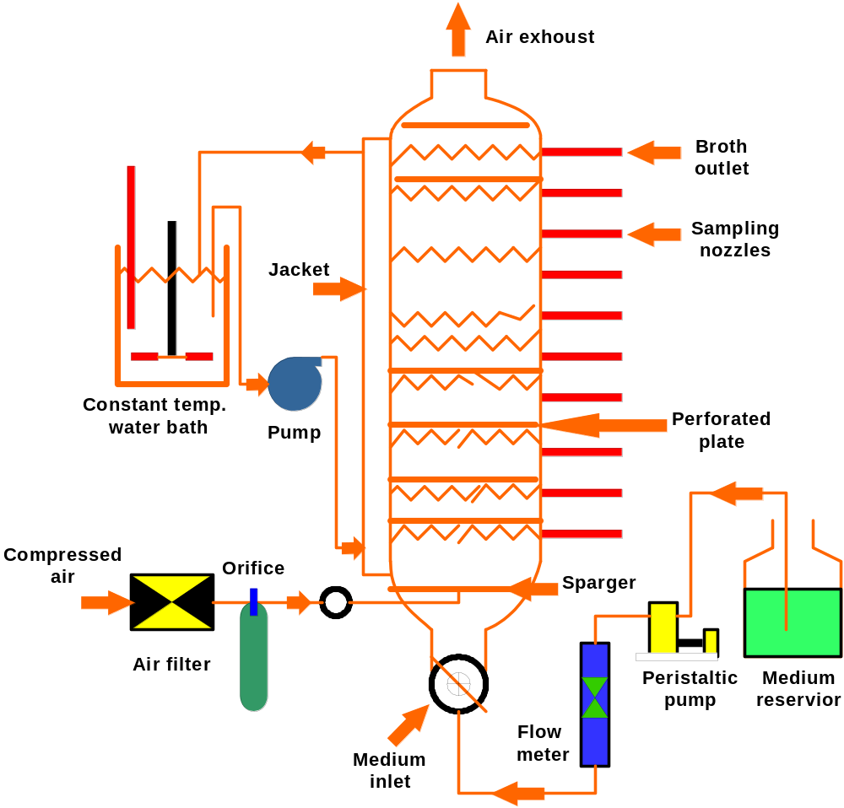
Schematic diagram of a tower bioreactor system with perforated plates and co-current air liquid flow.

Slide 25
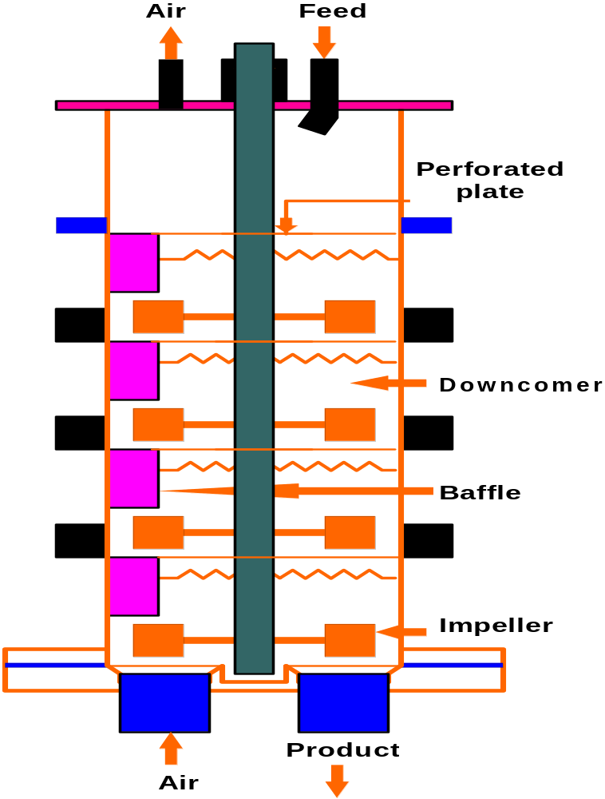
Schematic diagram of a tower bioreactor system with multiple impellers and liquid down comer and counter-current air liquid flow

Slide 26
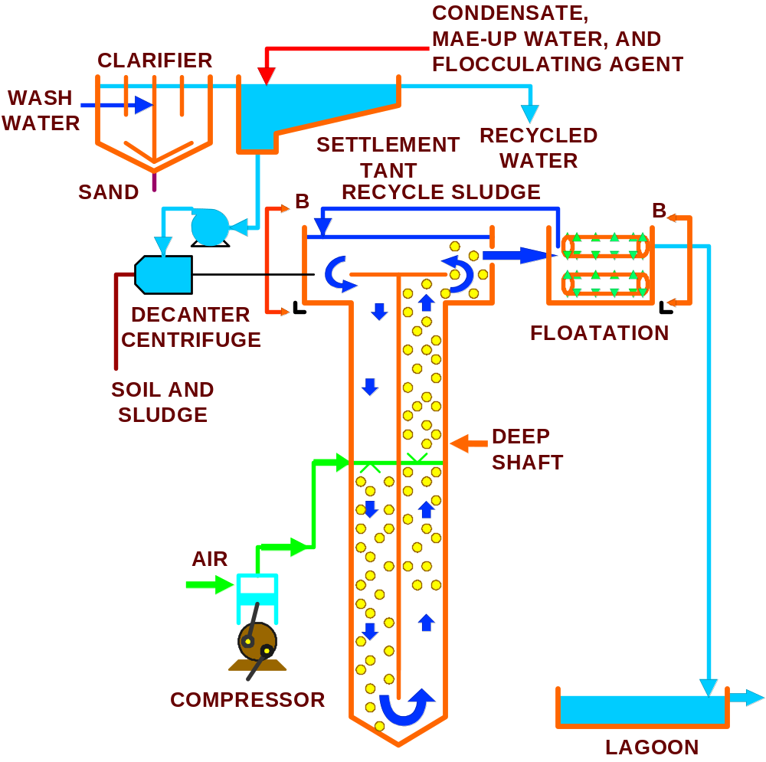

Slide 27
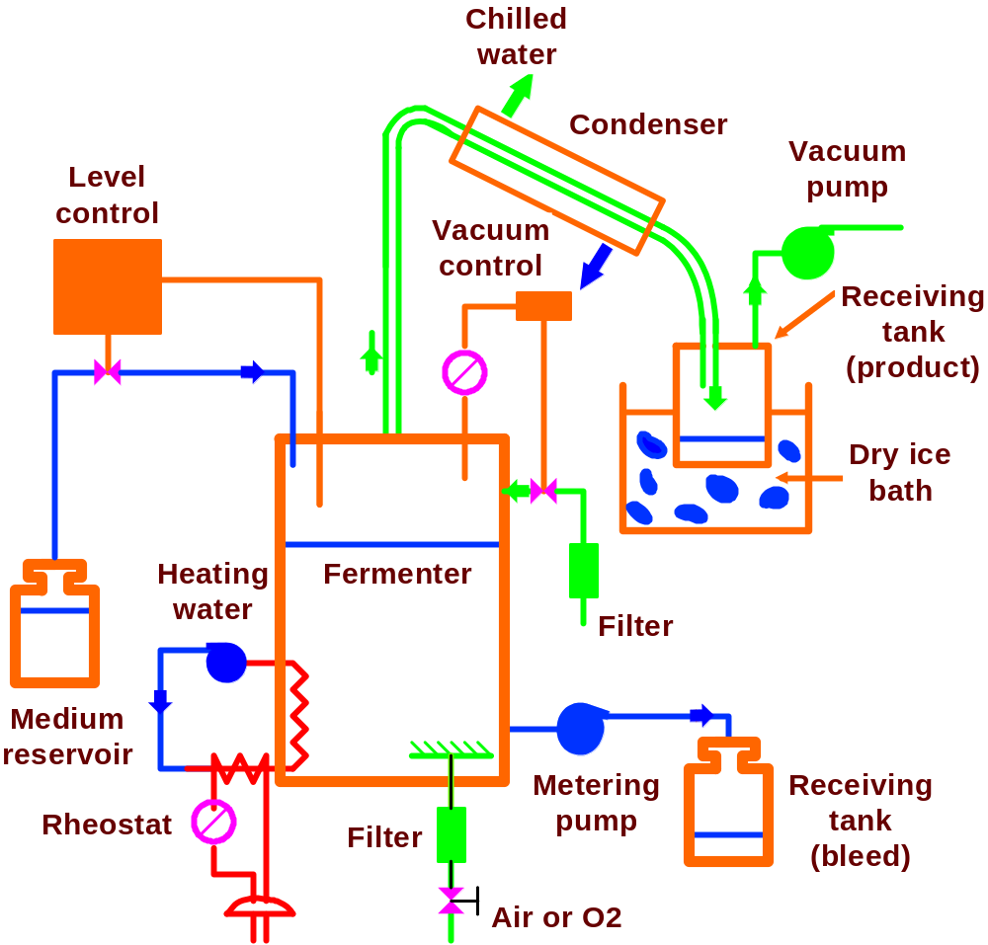
Vacuum Fermenter

Slide 28
Cell system:
In bioreactors the cell system employs two different ways
(i). Suspension cell system
(ii). Anchorage dependent cells
Hence, it is important to maintain above mention cell-line (mammalian, insect, hybridoma) in bioreactors with proper selection and operation
For product, proteins, viruses etc

Slide 29
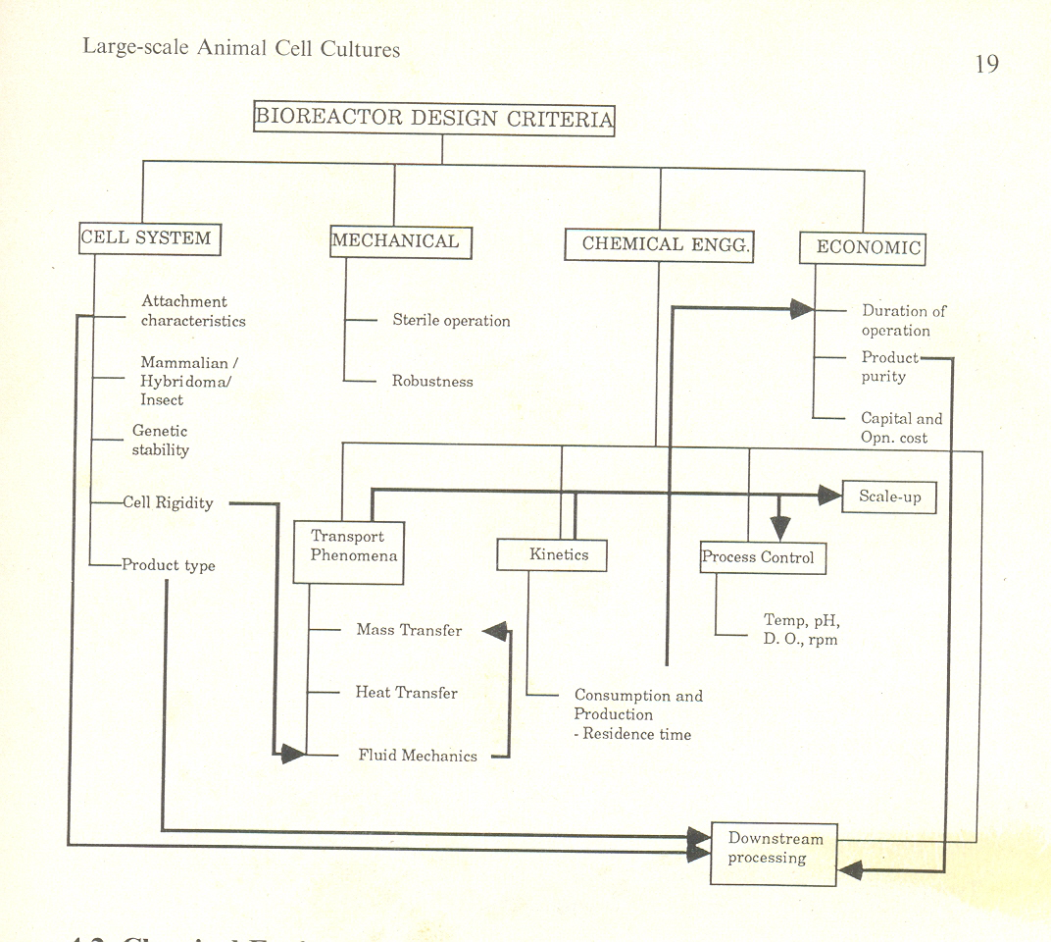
Bioreactor design criteria- Overview

Slide 30
Chemical engineering aspects:
Chemical engineer plays an important role in following mention parameters
Like process design, process parameters optimization and scale-up
The major drawback in animal cell cultures is:
Mass transfer
Heat transfer
Agitation/aeration

Slide 31
Application of fluid mechanics can over come up to solve the following problems
Diffusion limitation in immobilized cells
It helps in oxygen transfer rate, oxygen uptake rate, and necessary nutrient and volumetric liquid transfer coefficients kLa
Since animal cells are very delicate while processing in reactors hence shear stress important parameter to be consider
Maintenance of agitation/ aeration are also important

Slide 32
Determination of volumetric liquid mass transfer coefficient (k_{L}a):
Different types of methods are available to determine k L a
static gassing out
dynamic gassing out
oxygen balance method
and sulphite oxidation method
Oxygen transfer rate (OTR) : k_{L}a (C*-C_{L})
Oxygen uptake rate (OUR) : q_{max,}X_{max}
Where X_{max}=max biomass concentration
C*= equilibrium oxygen concentration
Diffusion limitation can be calculate based on Damkholer no: rate limiting or mass transfer limiting

Slide 33
Reactor types:
Current existing bioreactors used in multifarious technology are designed for specific process
In case of perfusion systems which are available commercially in three groups
Stirred tank provided with retain cells in a homogeneity manner and spin filters at high speed and filters which recycle the cells
Macroscopic homogeneity which achieve entrapment inside the polymer gels or fibrous collagen matrices (eg.,immobilization methods)
Non-homogenous e.g. irregular of ceramic cartridge surface and hollow fibers
These system are important in terms to estimate cell density and health on regular basis
Weighing the porous beads and mechanical stabilizations is another approach to determine the high cell density.

Slide 34
Reactors types:

Slide 35
Mode of operation:
These operation can be divided into three classes:
Batch
Continuous
Fed batch
In batch reactor mixing is presumed to be sufficiently intense and uniform such that reaction condition and biocatalyst are effectively homogenized eg, production proteins by infecting the host cells with recombinant viruses
In continuous reactor the operation process is continuous and mostly used for secondary metabolites where protein production is inversely proportional to cell growth
In fed batch reactor precursor and inducers are used to maintained the nutrient level to minimize the catabolic repression or to extend stationary phase to get additional product

Slide 36
Scale-up
Theoretically the following criteria are the basis for scale-up in bioreactors
Power
Constant kLa
Constant mixing quality
Momentum factor
Similar drop size distribution
Constant impeller speed
Constant mixing rate
Currently 500-3000 L have been used for vaccine and interferon production
The above mention criteria is not sufficient for animal cell system
Dimensionless numbers showed relative importance to these cell system like Reynolds number, Sherwood are used to interpret interfacial and molecular diffusion continue……..

Slide 37
Existing and non existing barriers in scale-up of mammalian cell cultures:
Barrier type | Barrier species
Already overcome to some extent Still to be overcome | Low surface to volume ratios of systems for anchorage dependent cells Shear sensitivity of mammalian cells Oxygen transfer limitation Accumulation of toxic product Lack of regulatory hardware and software for process control High cost of serum

Slide 38
Downstream processing:
Bioseparation is an essential part of bioprocess technology
For desired product needs to be isolated, purified and formulated for different end uses
Substances of potential biological hazard include viral or cellular DNA fragments, proteins etc
Factors affecting product safety/ purification are
The product
In purification of product depends on nature of the contaminants, degree of purity and product of interest
The better way to achieve the best biological safety and product potency is by control process and even with screening the cells about 50 generations and supplements during production

Slide 39
Process scheme
separation of cells in downstream can be done by immobilized/entrapped mode of cell which drastically cut down initial separation
Concentration of product depends on cell density, cell culture, mode of operation etc
Product purity and concentration
Final purification depends on
Therapeutic, diagnostic,immunopurification etc
Product value
Finally it has to approved by FDA or National regulatory authorities for product purity

Slide 40
Cell culture medium:
As per griffiths prediction medium costs are typically as much as 40% of the total production costs and hence necessary steps consider for process finalization
Serum constitute about 17-84% of medium costs
Production of serum-free media has been forecast and fast-growing market about 30-40% per year growth
From serum-containing to serum-free during continuous operation increases the specific productivity as well as enhance product purity
Still exact mechanism not know to explain this phenomenon
In terms of economic aspects it has shown advantage both in reduced medium cost and higher product purity

Slide 41
The need : bioreactor design in terms
Structural
Conformational
And biological has to develop for scale-up
Scale-up of the conventional biological methods need to develop the process design
In terms of
Reliability, predictability and regulatory

